Slide 1

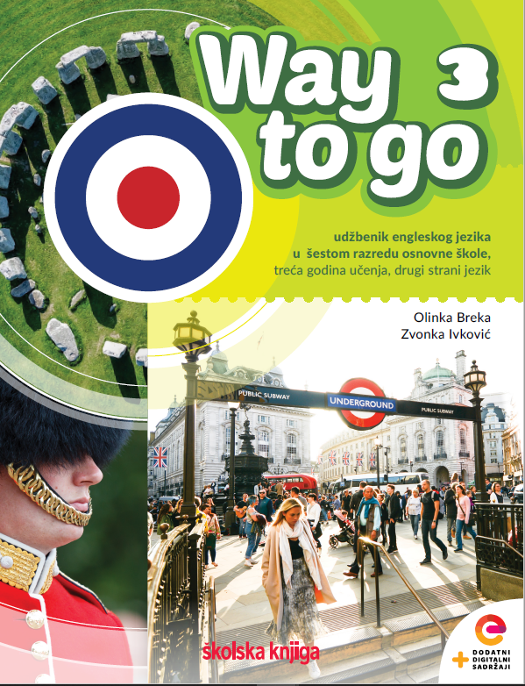
Unit 5: Culture spot 5 Street festivals in the UK

Slide 2
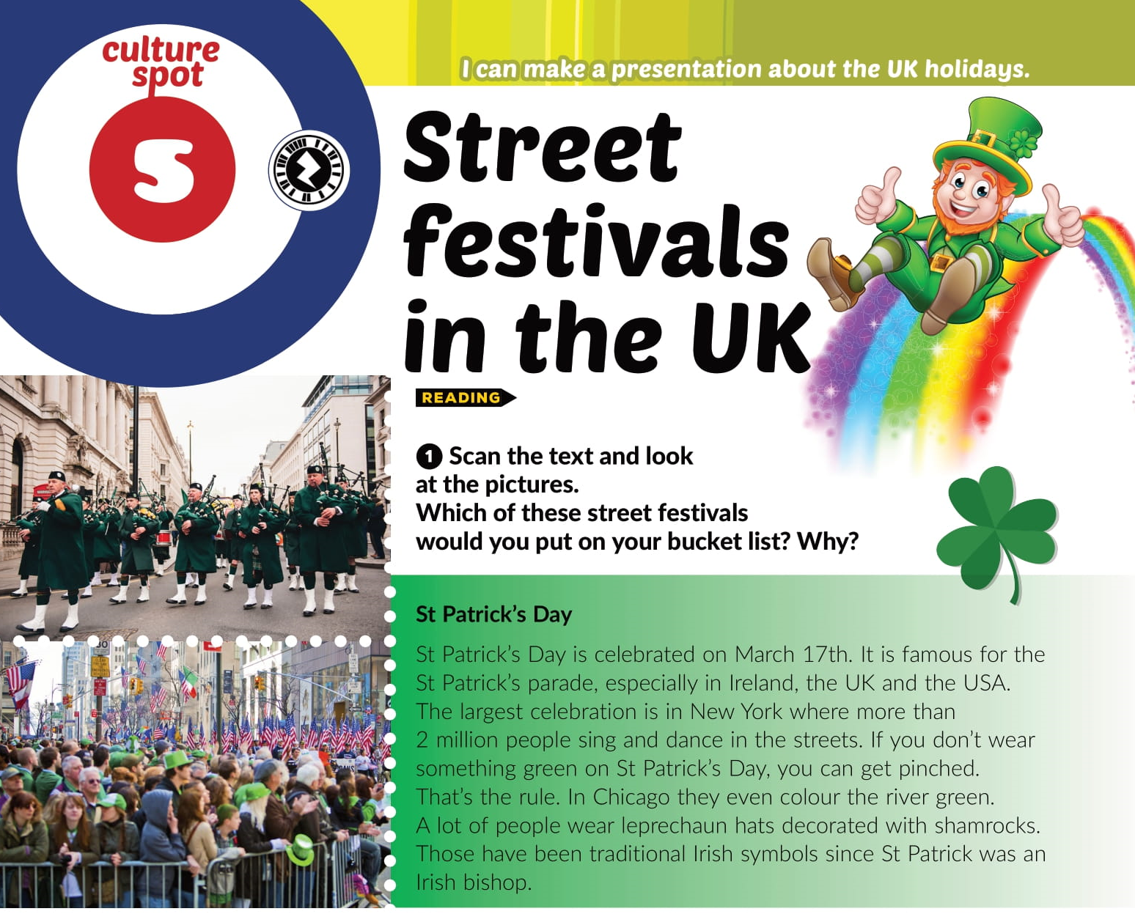

Slide 3
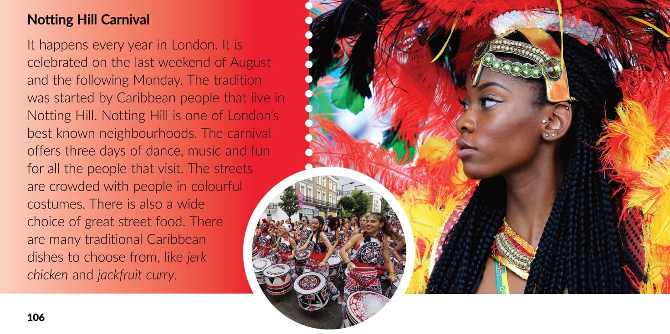

Slide 4
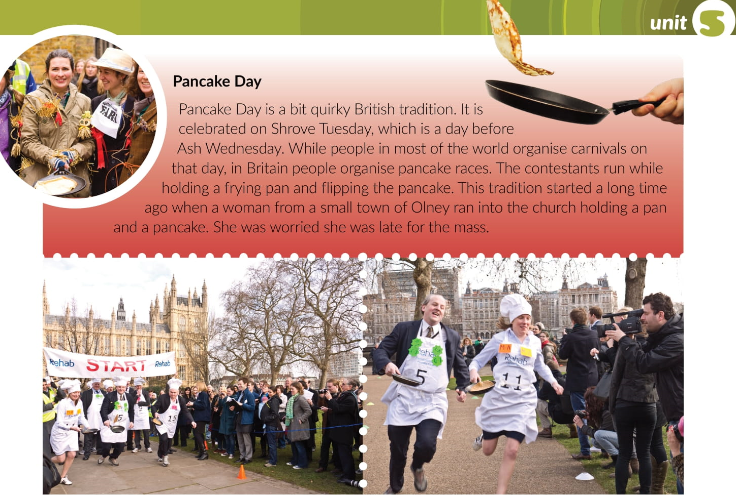

Slide 5
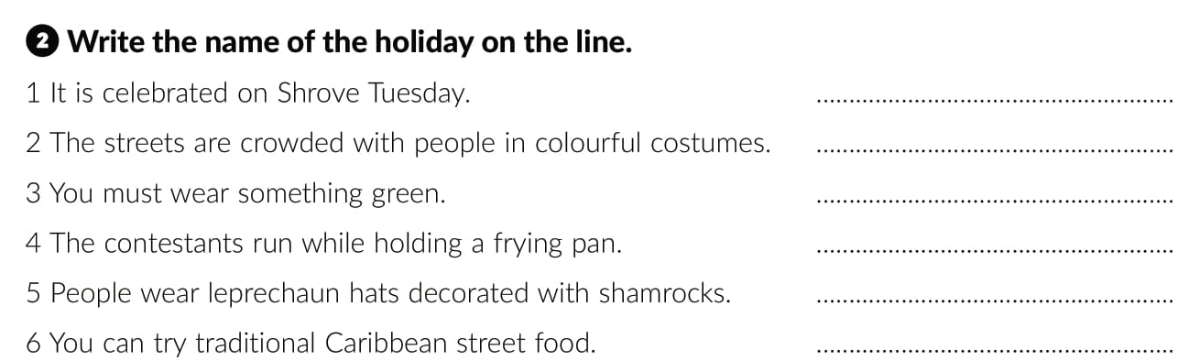
Pancake day
Notting Hill Carnival
St Patrick’s Day
Pancake day
St Patrick’s Day
Notting Hill Carnival

Slide 6
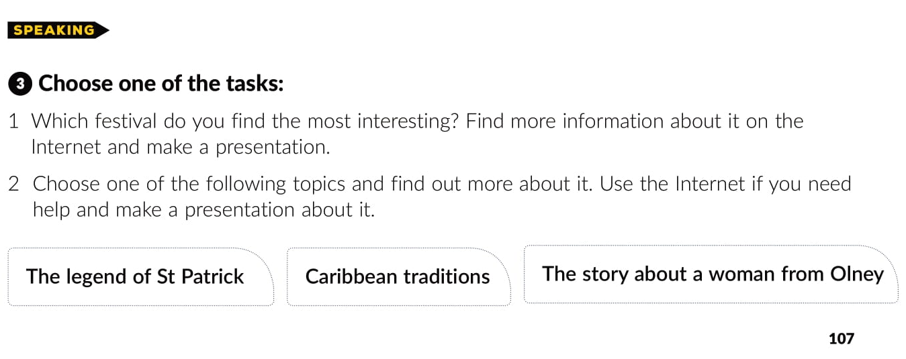

Slide 7
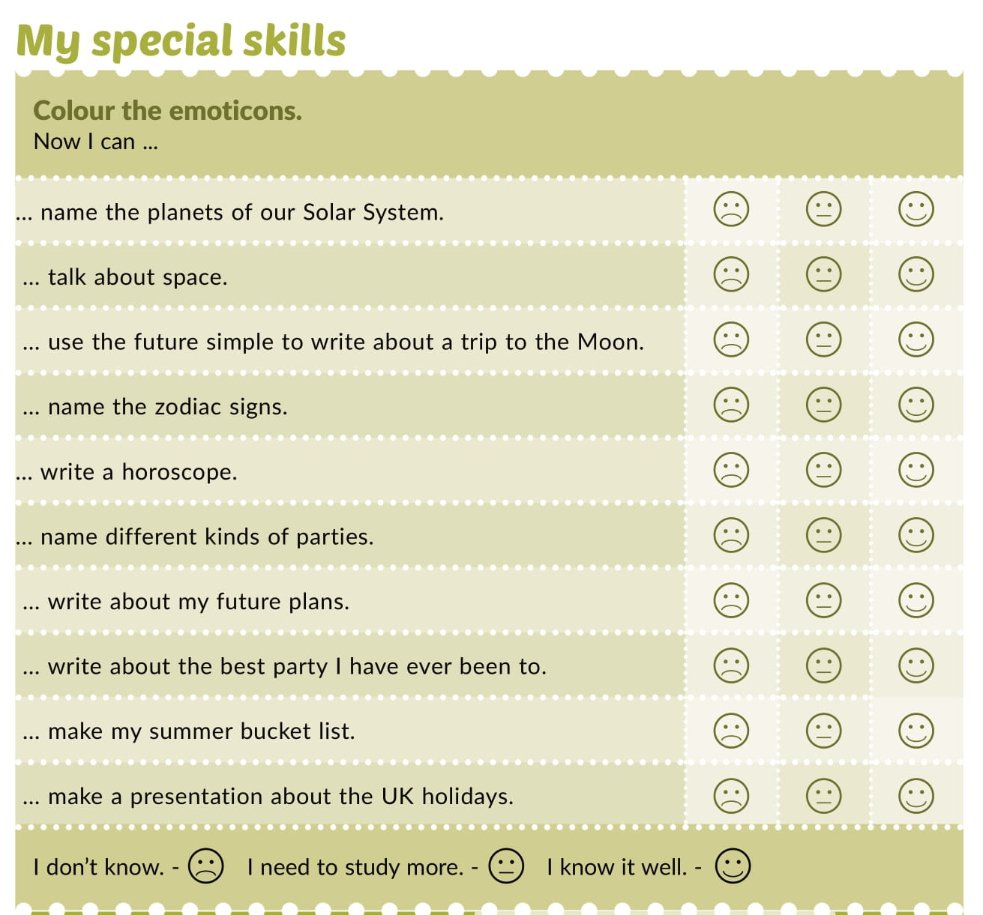

Slide 8
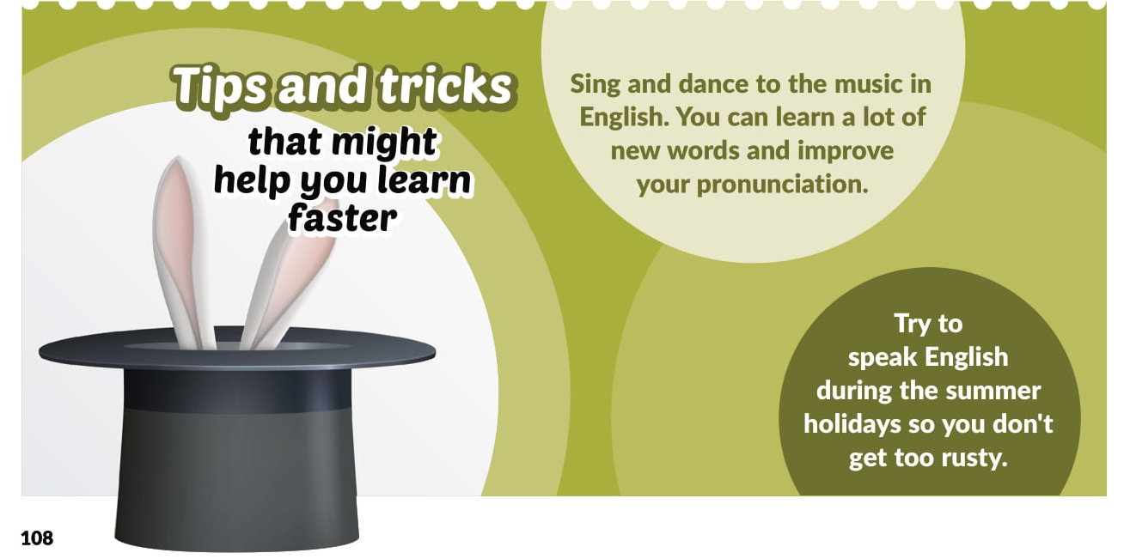

Slide 9

Otvori sljedeću poveznicu, te odaberi LEARN MORE!
Culture spot 5 | Way to go 3 (e-sfera.hr)

